Slide 1
The Medicine Wheel

Slide 4
The Seasons

Slide 5
The four times of day & night

Slide 6
The four sacred plants

Slide 7
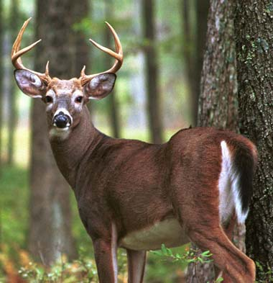
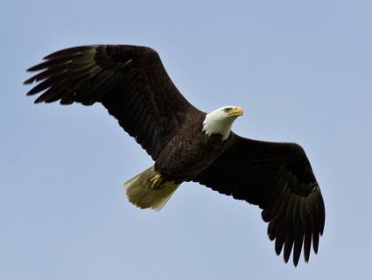
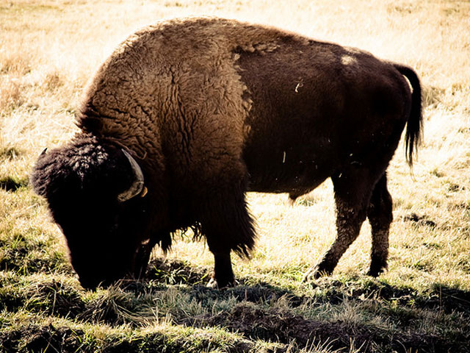
The four animals

Slide 8
The four elements

Slide 9
The four stages of life

Slide 10
The four aspects of human beings

