Slide 1
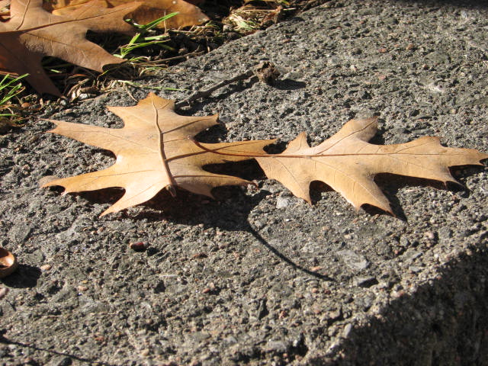
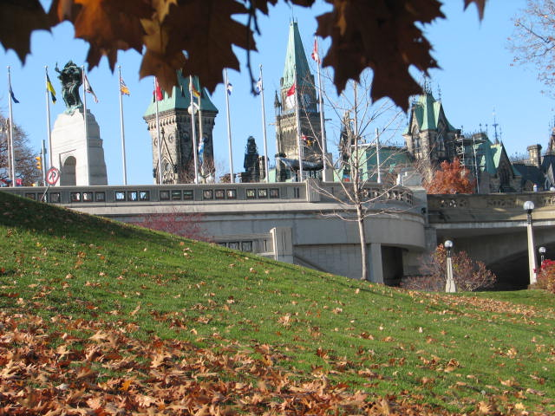
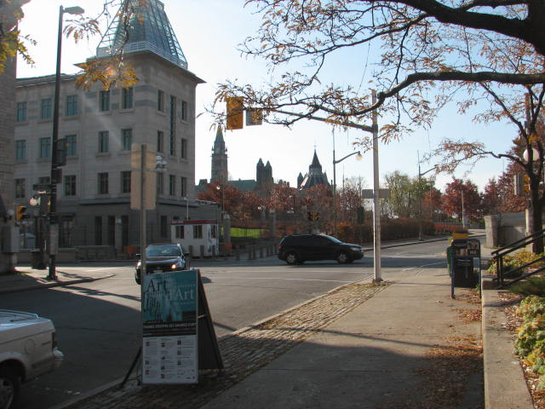
Ottawa - november 2009
Teacher’s Institute of Parliamentary Democracy

Slide 2
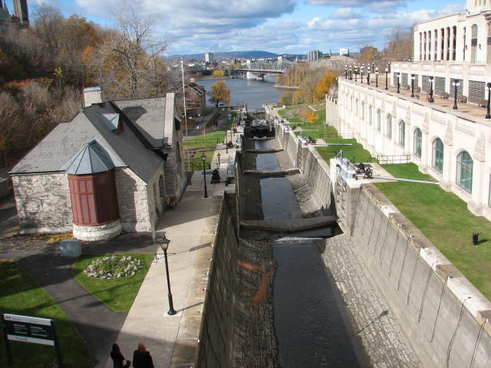
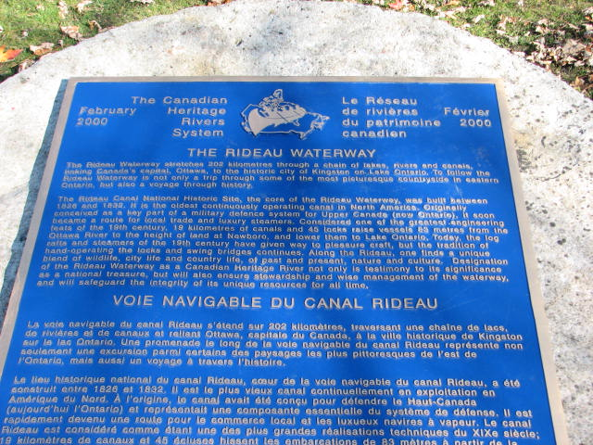
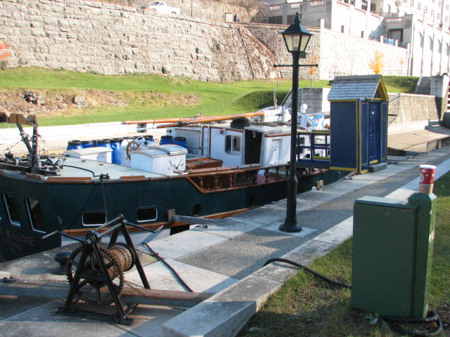
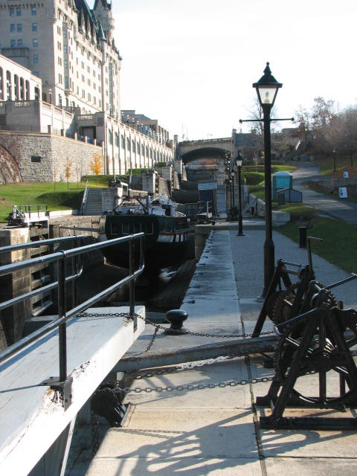
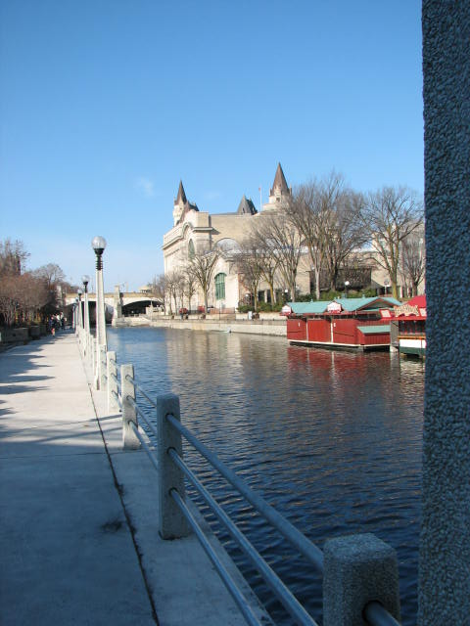
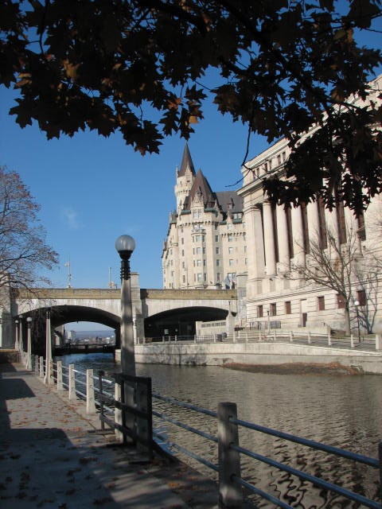
Rideau Canal

Slide 3
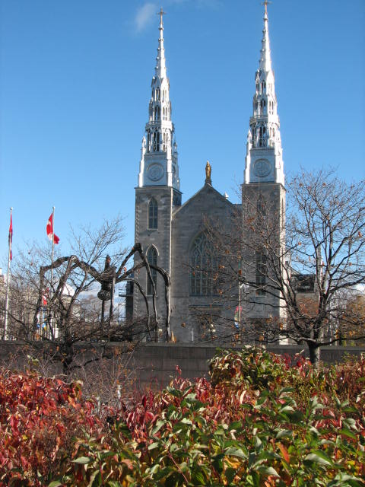
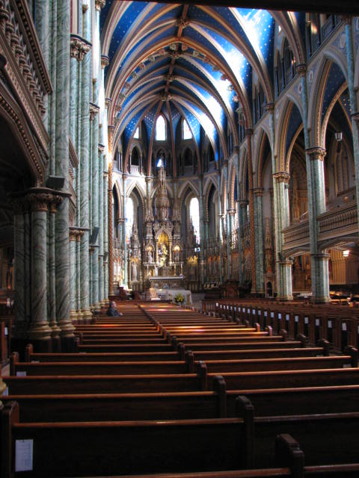
Catholic Church

Slide 4
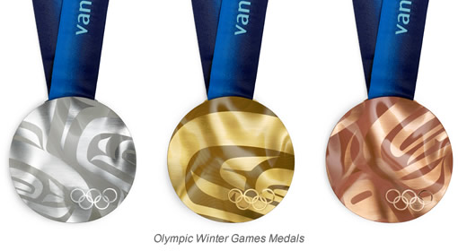
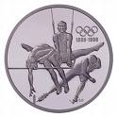
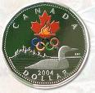
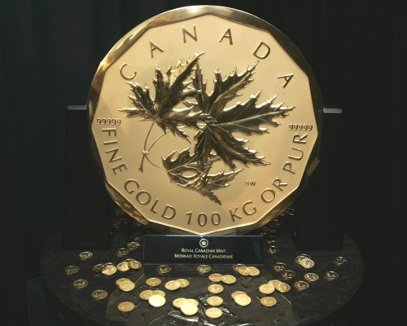
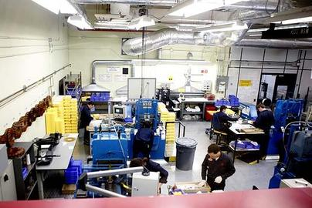
World’s Largest Gold Coin - $1 000 000+

Slide 5
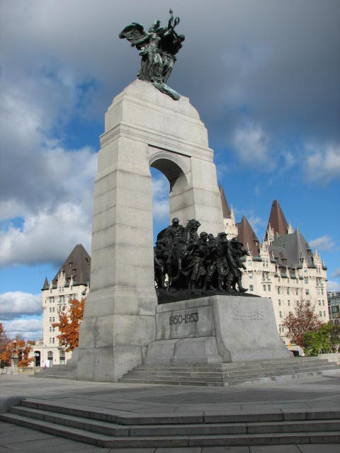
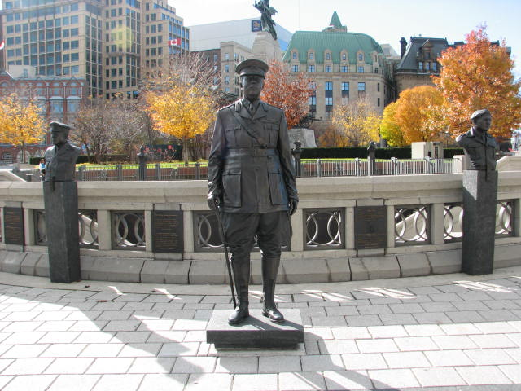
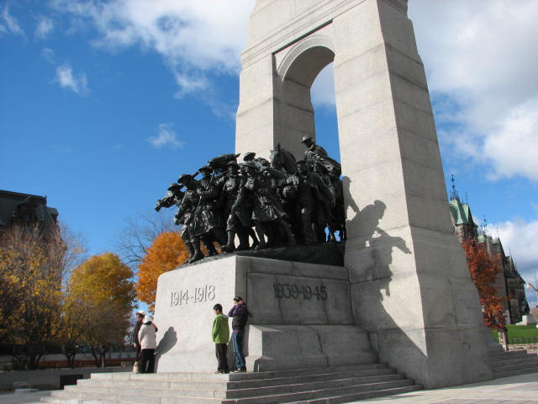
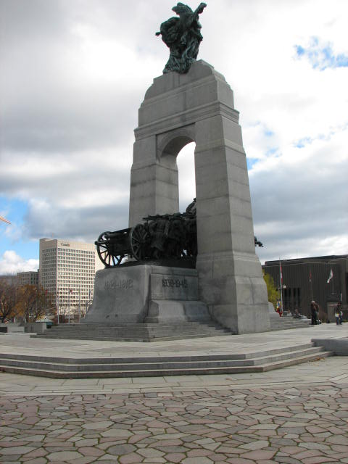
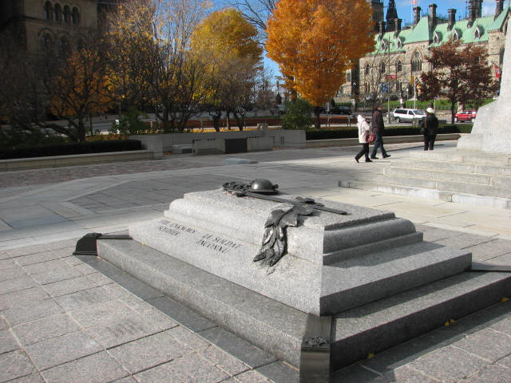
National War Memorial
Tomb of Unknown Soldier

Slide 6
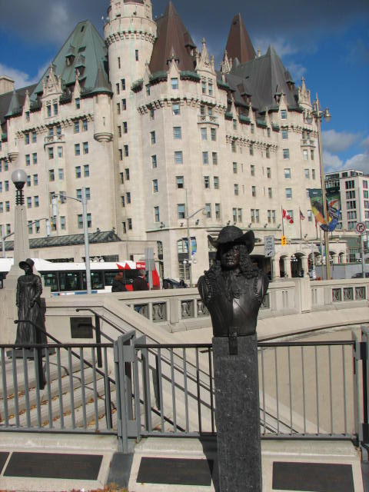
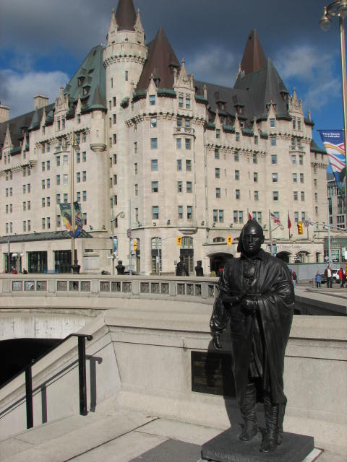
Chateau Laurier

Slide 7
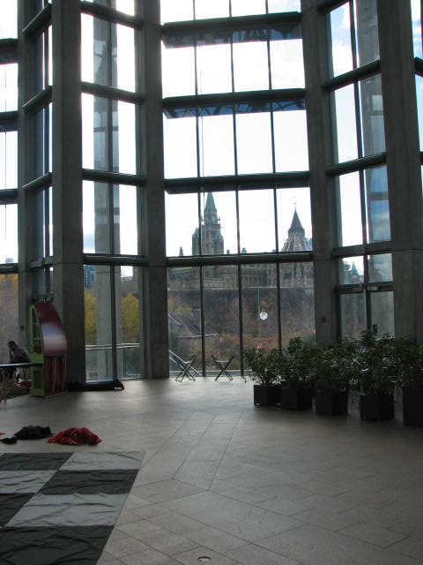
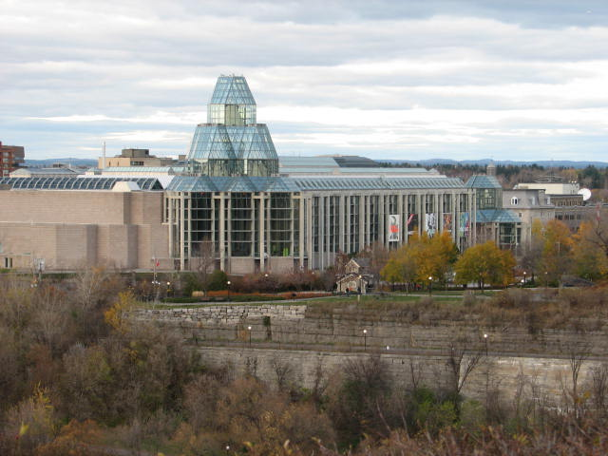
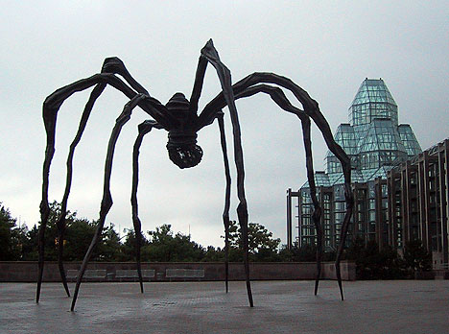
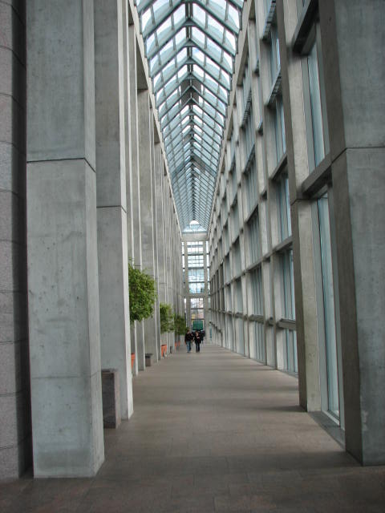
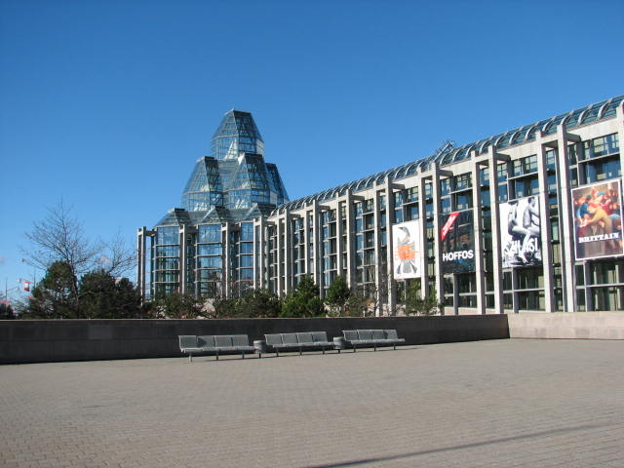
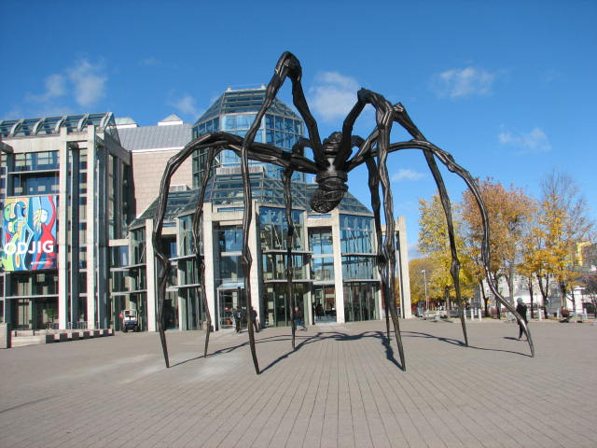
National Gallery of Canada

Slide 8
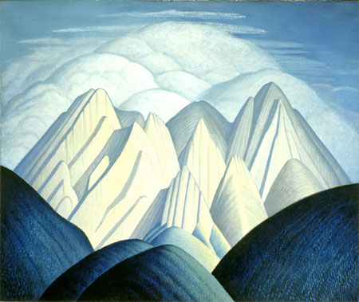
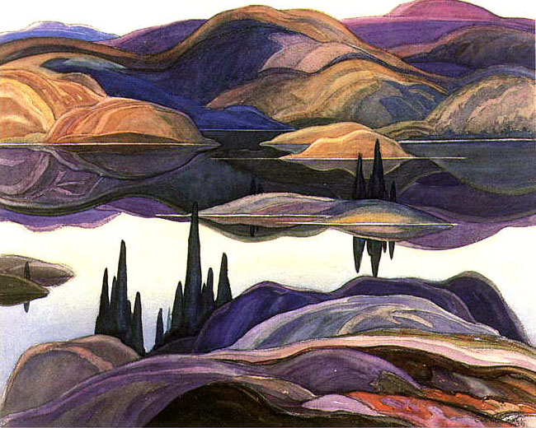
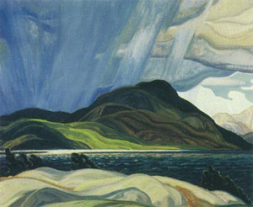
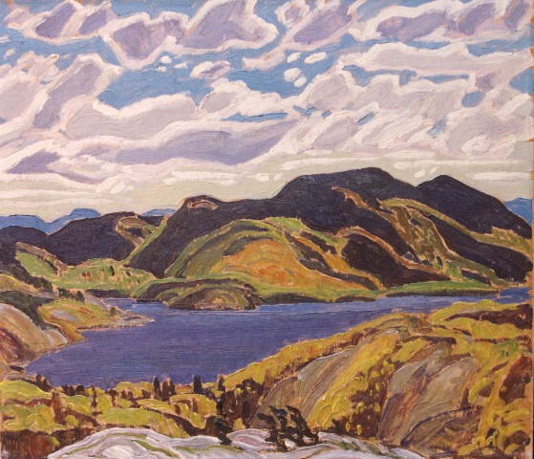
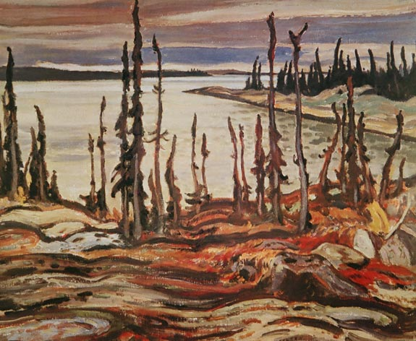
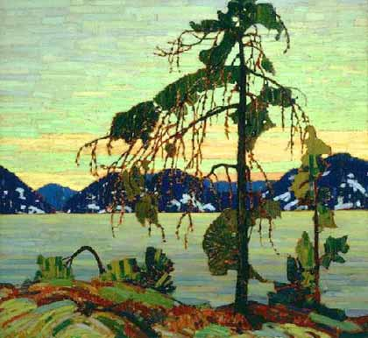
Group of Seven
Canada Most Famous Landscape Artist 1920’s

Slide 9
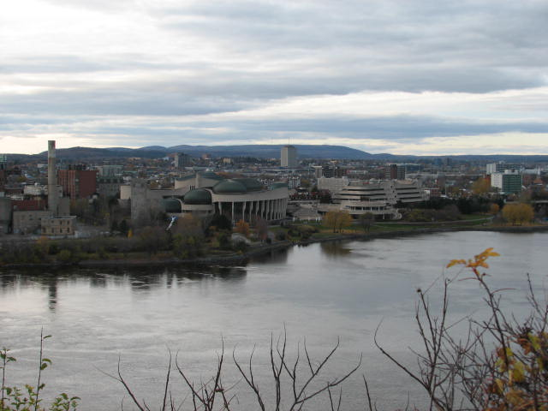
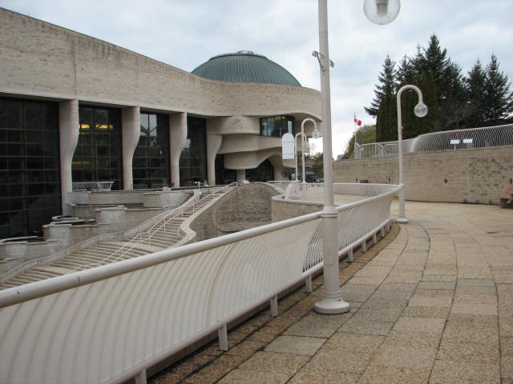
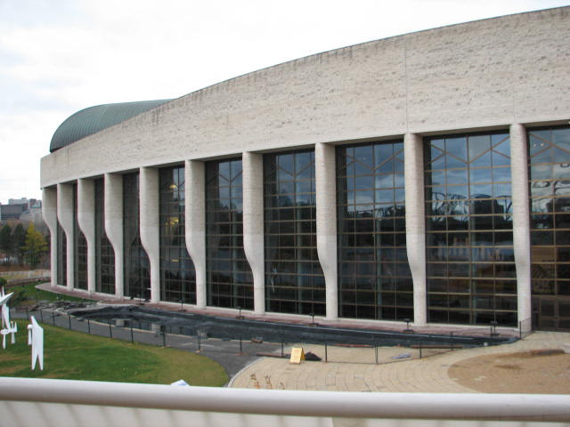
Canadian Museum of Civilization Gatineau, Quebec

Slide 10
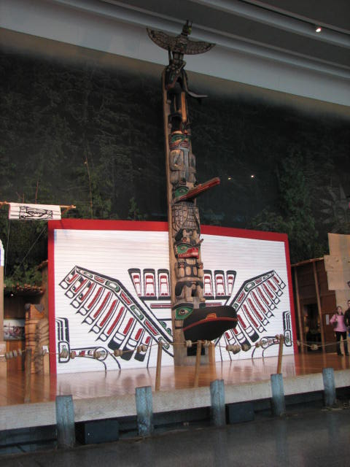
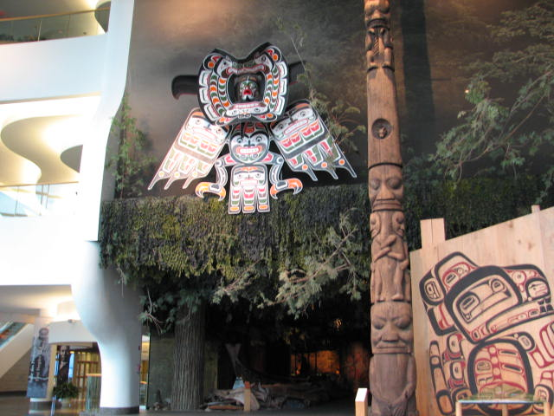
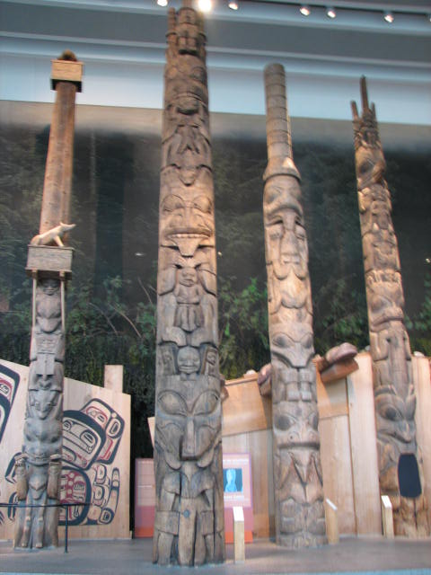
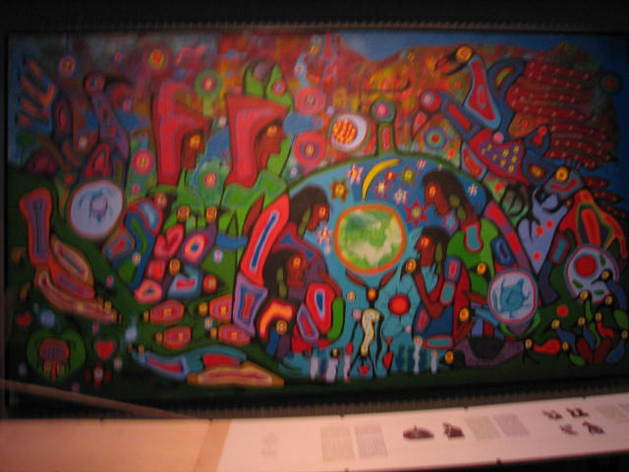
Canadian Museum of Civilization Gatineau, Quebec

Slide 11
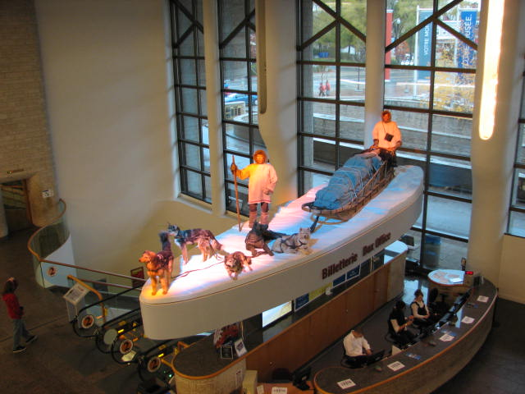
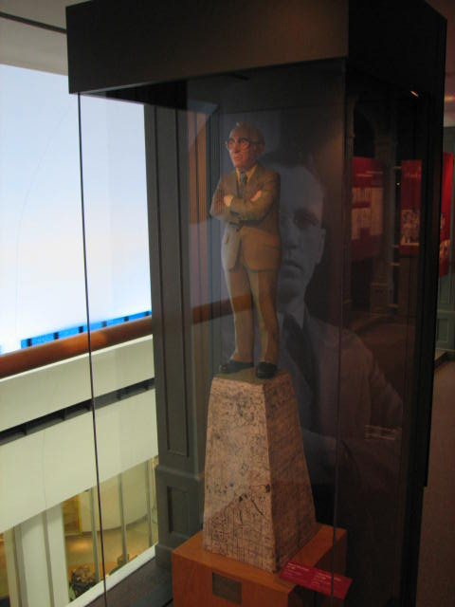
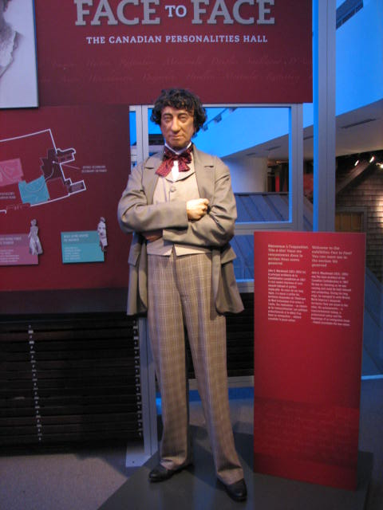
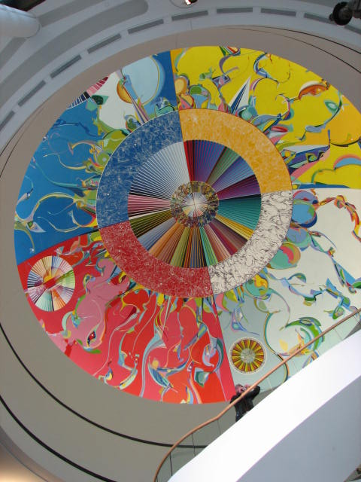
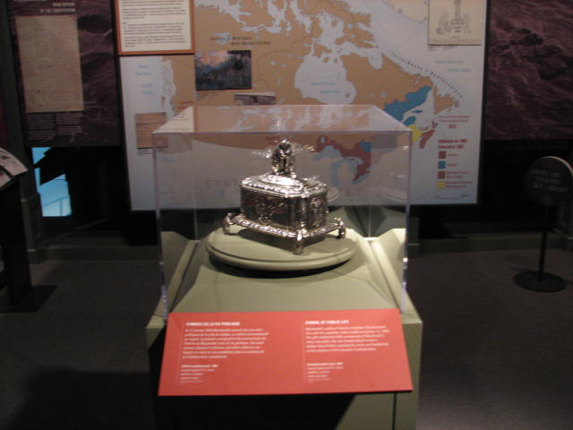
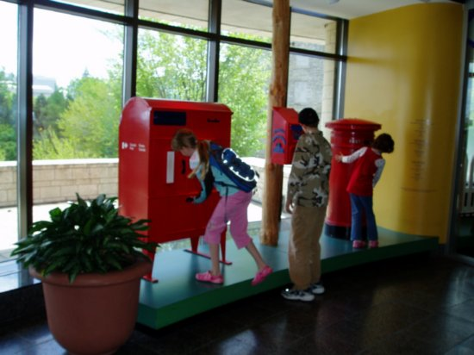
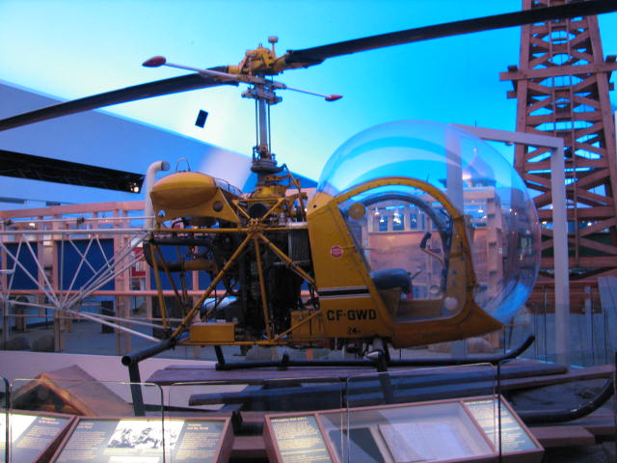
CanadianMuseum of Civilization

Slide 12
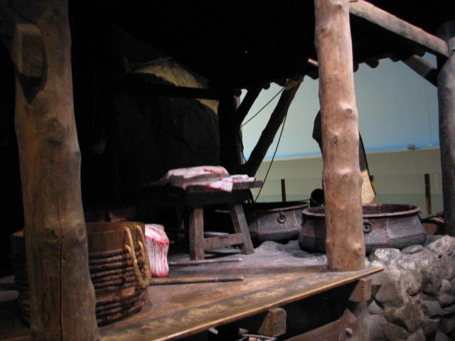

Slide 13
Parliament of Canada
Center Block
Center Block
West Block
East Block

Slide 14
On the Hill
Library
Darcy McGee
Original Tower Bell
Elizabeth II
Diefenbaker
Famous Five
Centenniel Flame

Slide 15
House of Commons

Slide 16
Parliament Building Tour

Slide 17
Library of Parliament

Slide 18
The Senate

Slide 19
The Senate

Slide 22
Mock Trial

Slide 23
Canadian War Museum

Slide 24
First Nations
Iriquois Longhouses

Slide 25
Battle of Quebec 1759

Slide 26
Northwest Rebellion 1885

Slide 27
20th Century – British Empire
Canada enters the South African War

Slide 28
World War I

Slide 29
Women and Children Go to War

Slide 30
World War II
Hitler’s Car

Slide 32
Peace Tower
Centenniel Flame
Down
Up
Gatineu Quebec
US Embassy
Ottawa River
Ceiling
North
East
Chateau Laurier
Supreme Court
South
West

Slide 33
The Memorial Chamber
Inside the Peace Tower Canadians Remember all those who have died for our freedom in all battles since 1860’s.
.

Slide 34
Canada Remembers
Engraved in Walls for Eternity
Remembrance in the form of Prose,Poetry and Prayer share our story.

Slide 35
Canada Remembers
World War I
All of Canada’s military campaigns since 1866 are also engraved into the chamber walls.
Books of Remembrance
All who have given the ultimate sacrafice in Service of Canada are remembered within these treasured books
Daily Ceromony
Everyday at 11:00 AM a military ceremony insures every page is visible once annually by turning pages.

Slide 36
Canada Remembers
.
.

Slide 37
Merchant Navy
Korean War
All Peace Keepers including Afghanistan sacrafices
Dominion of Newfoundland

