Slide 1
HOMEROOM TEACHER:
Mr Guy Farquharson (Mr. Farq) u OF s Intern: Eric Son
Grade 8 – 2018/19

Slide 2
Mr Farq
Homeroom teacher: Ela, math, social studies, DDM, pe, health
Second year at wcms (17-19)
Previous schools Warman High (08-17), Delisle composite (96-08), Dalmeny high (84-96), morse school, (81-83), chaplin school (80-81), mankota( 77-78)
Junior basketball coach nov-feb (cvac team) - tryouts November -
Married (cindY) with three kids; brett (31), Riley ( 29) and katie (25)
Home: Saskatoon Fairhaven since 2001
Enjoys summers and weekends at cabin – Christopher Lake

Slide 3
Mr eric son
other
current intern at wcms
Jr boys basketball coach (with mr. farq)

Slide 4
Introduction share game
Your name
What is the most fun thing you did this summer?
Who was your teacher last year?

Slide 5
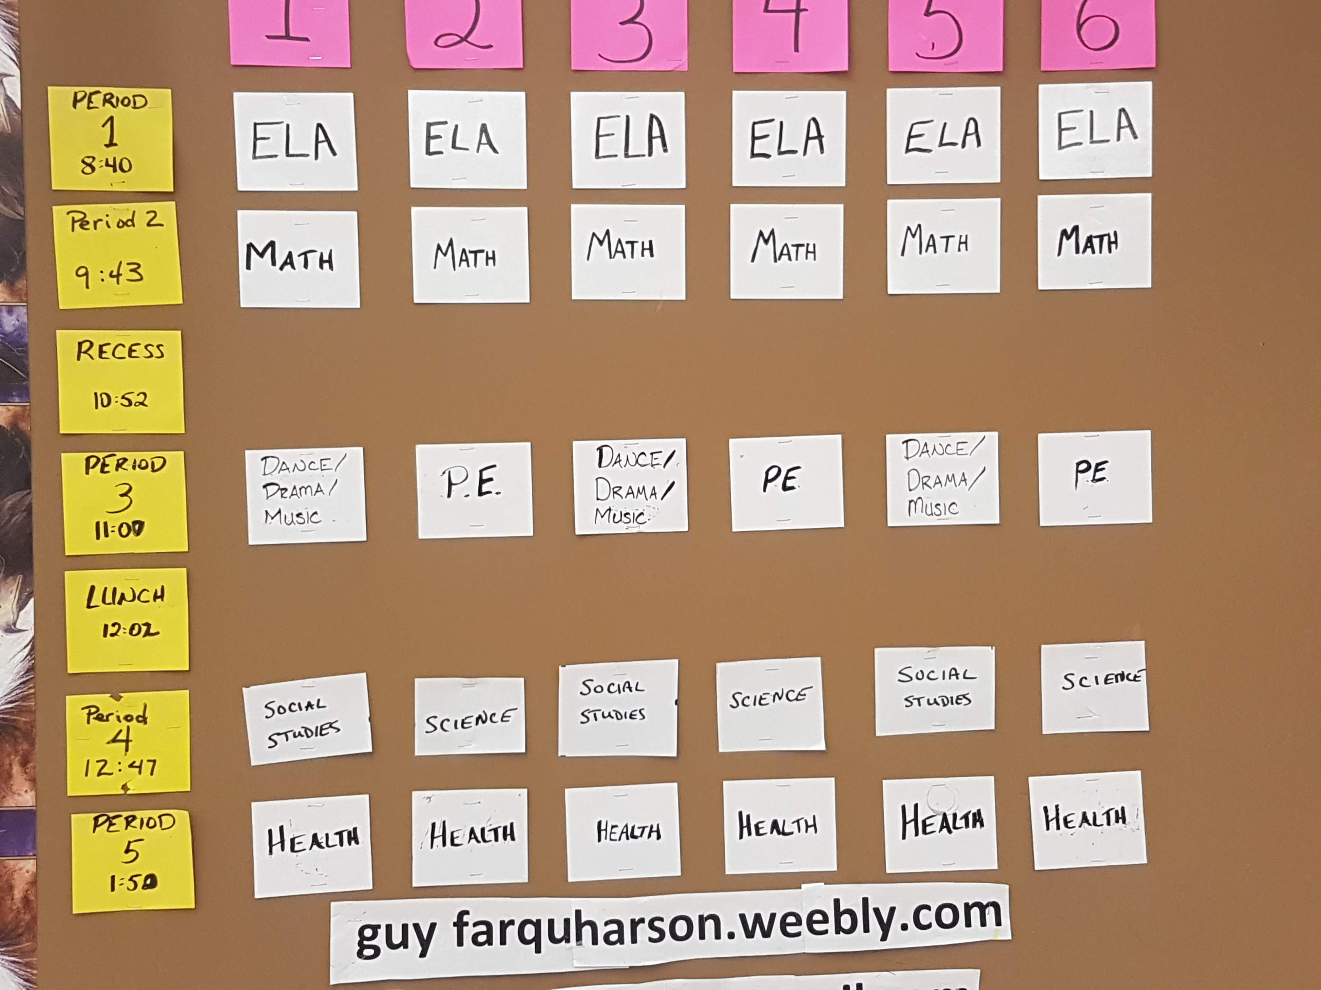
Class schedule

Slide 6
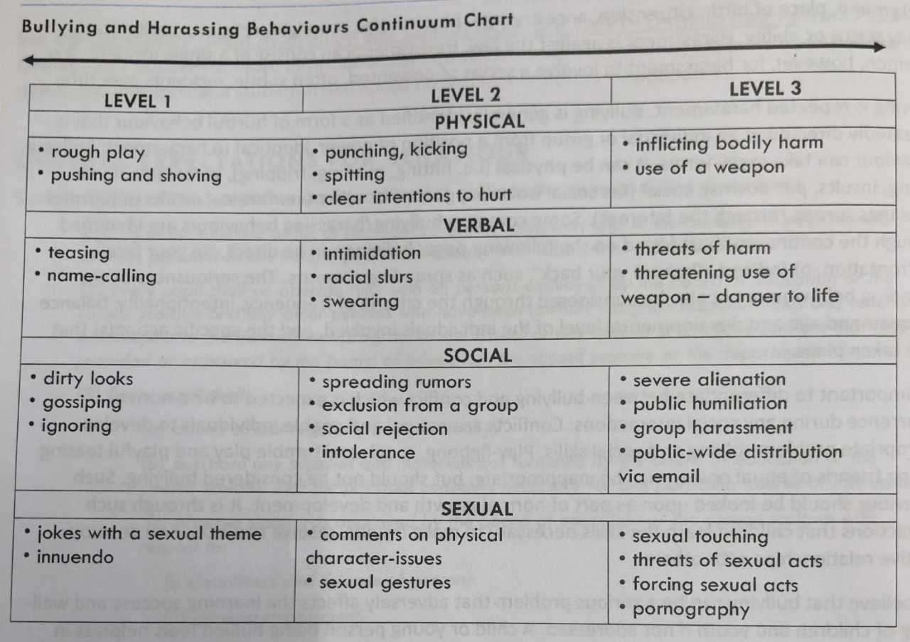
Bullying and Harassing Behaviors

Slide 7
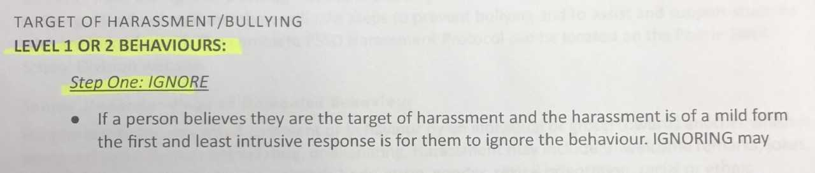
What do you do? Level 1 or 2

Slide 8
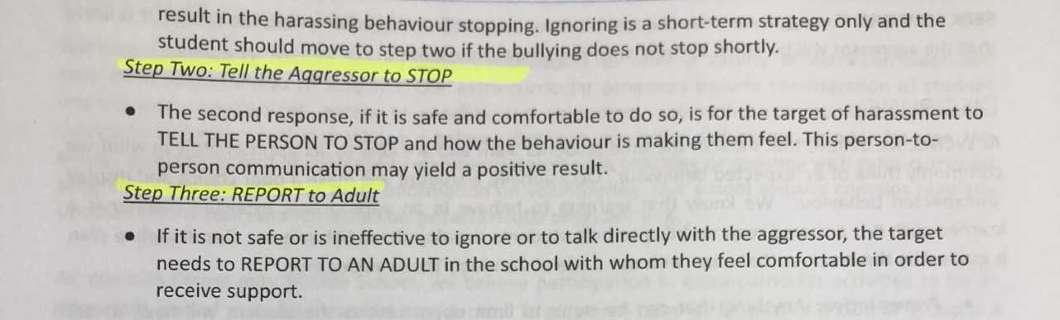
What do you do? Level 1 or 2

Slide 9
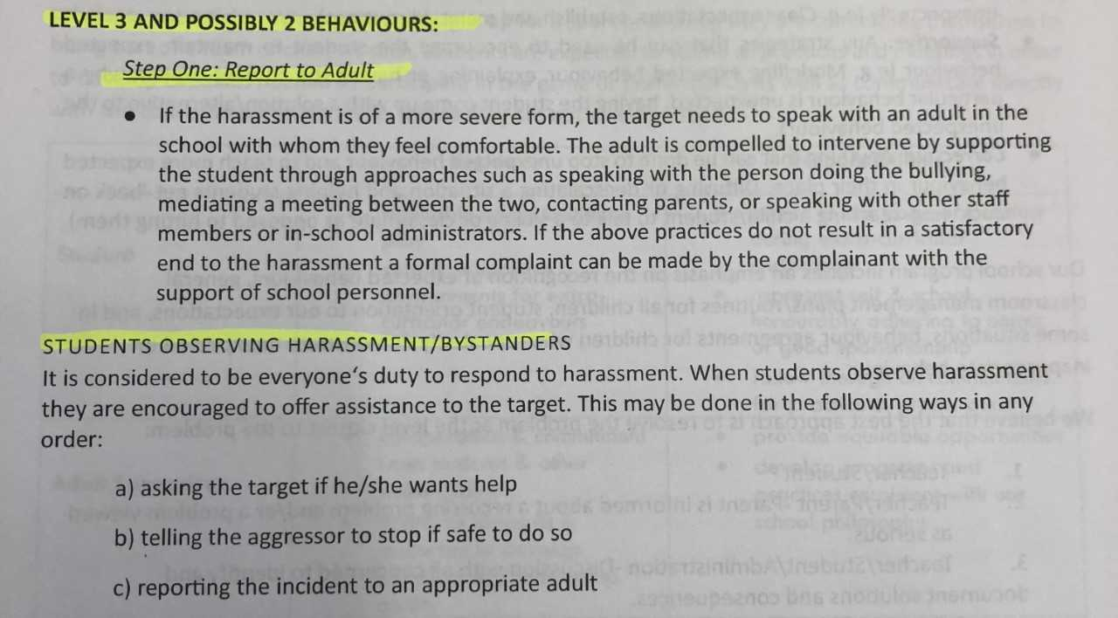
What do you do? Level 3 (maybe 2)

Slide 10
Library
Need a library pass during class time
Need to use library card or picture on phone (No fob’s this year!!)
book exchange – Wednesdays during ela

Slide 11
attendance
Will be taken at the beginning of every class period
Parents will get an email or phone call if absent or late

Slide 12
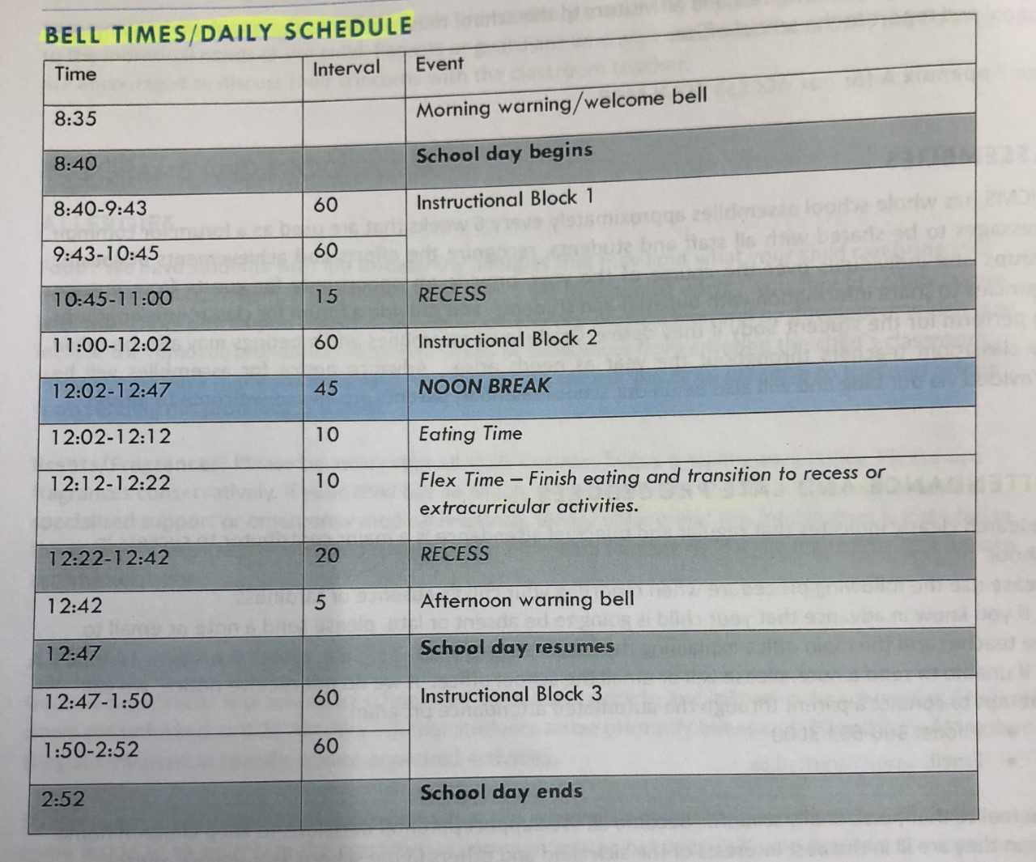
Bell times

Slide 13
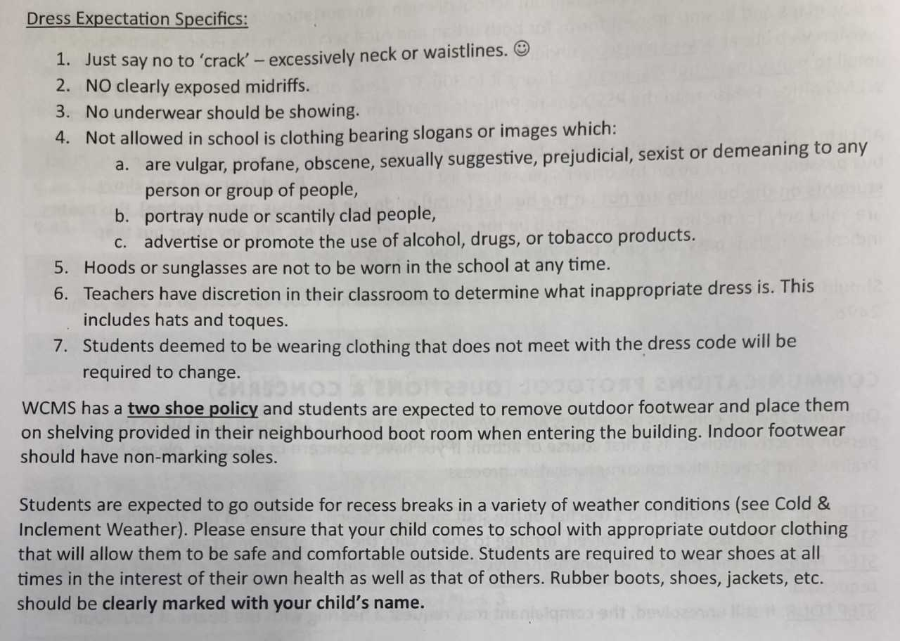
Dress code and two shoe policy

Slide 14
Recess – morning & lunchtime
Morning – go outside from 10:45 – 11 am
(inside options will be available when cold out – until then go outside )
Lunch – go outside from 12:22-12:42 pm
(options – intramurals in gym start in November (ish), library, off campus with form)
Classroom will not be available during these times so make other arrangements based on the rules.

Slide 15
Cell phones – can be….
A useful educational tool
A distraction from learning for you and others.
Addictive
Use d during recess breaks
Used following teacher permission or request
(unless you are a repeat offender who has lost this privilege)

Slide 16
Cell phones - cannot
No cell phones allowed in hallways during class time!
  All Teachers will be confiscating any cell phones for the remainder of the school day if visible during class time in the hallway.
No cell phones should ever be visible during instruction time
  Not on desks, in desks or in pockets.
  You can hand in to teacher or keep In your locker.
No cell phones being used without permission from the teacher
  Consequence will be the phone is confiscated for the entire school day!
Repeated violations will result in the student losing the privilege of bringing personal technology to the school.

Slide 17
Classroom cleanliness
Keep your locker clean and orderly.
Spills and other messes – you did it – you clean it immediately.
Period 2 – desk and floor area should be clear of paper and debris before recess
Period 3 – ddm band students – clear desk by putting materials in locker.
Pe – we will be taking attendance in classroom and floor must be clear before you go get changed for pe
Period 5 – health– last 5 minutes we will clean classroom of anything on the floor and will put the chairs up

Slide 18
Online power school information
Online information will be included on your forms.
Add the app to your phone to see current assessments as I post them..

Slide 19
See saw information
Open the Seesaw Class app. Or go to https://app.seesaw.me on your computer.
Choose "I'm a Student".
Scan QR Code in classroom.
Scan with Seesaw App or Seesaw Website
***Do not photograph or share this code on social media***

Slide 20
Seesaw attempt
We are going to try to do a welcome activity
Record or edit note template to add a response

Slide 21
Forms
Return by Friday, September 7
Treats for people who bring the forms back on Wednesday or Thursday this week!
*Seesaw form

Slide 22
Pe Period 3 – begins tomorrow day b, d, f
After recess come to classroom for Attendance and clean up
Go get changed- gym clothes (don’t stink up the class)
3 Laps, Dynamic Warmup, Sit ups, pushups, stretch
Fun games to start off Pe for this week
Sept Outdoor activities – begin next week – soccer, football, ultimate frisbee, etc

Slide 23
French period 5 today
Remember to bring:
French – English dictionary
Binder or duo tang
Pen or pencil

