Slide 1
Grade 8 ELA Novel Study 2016-17

Slide 2
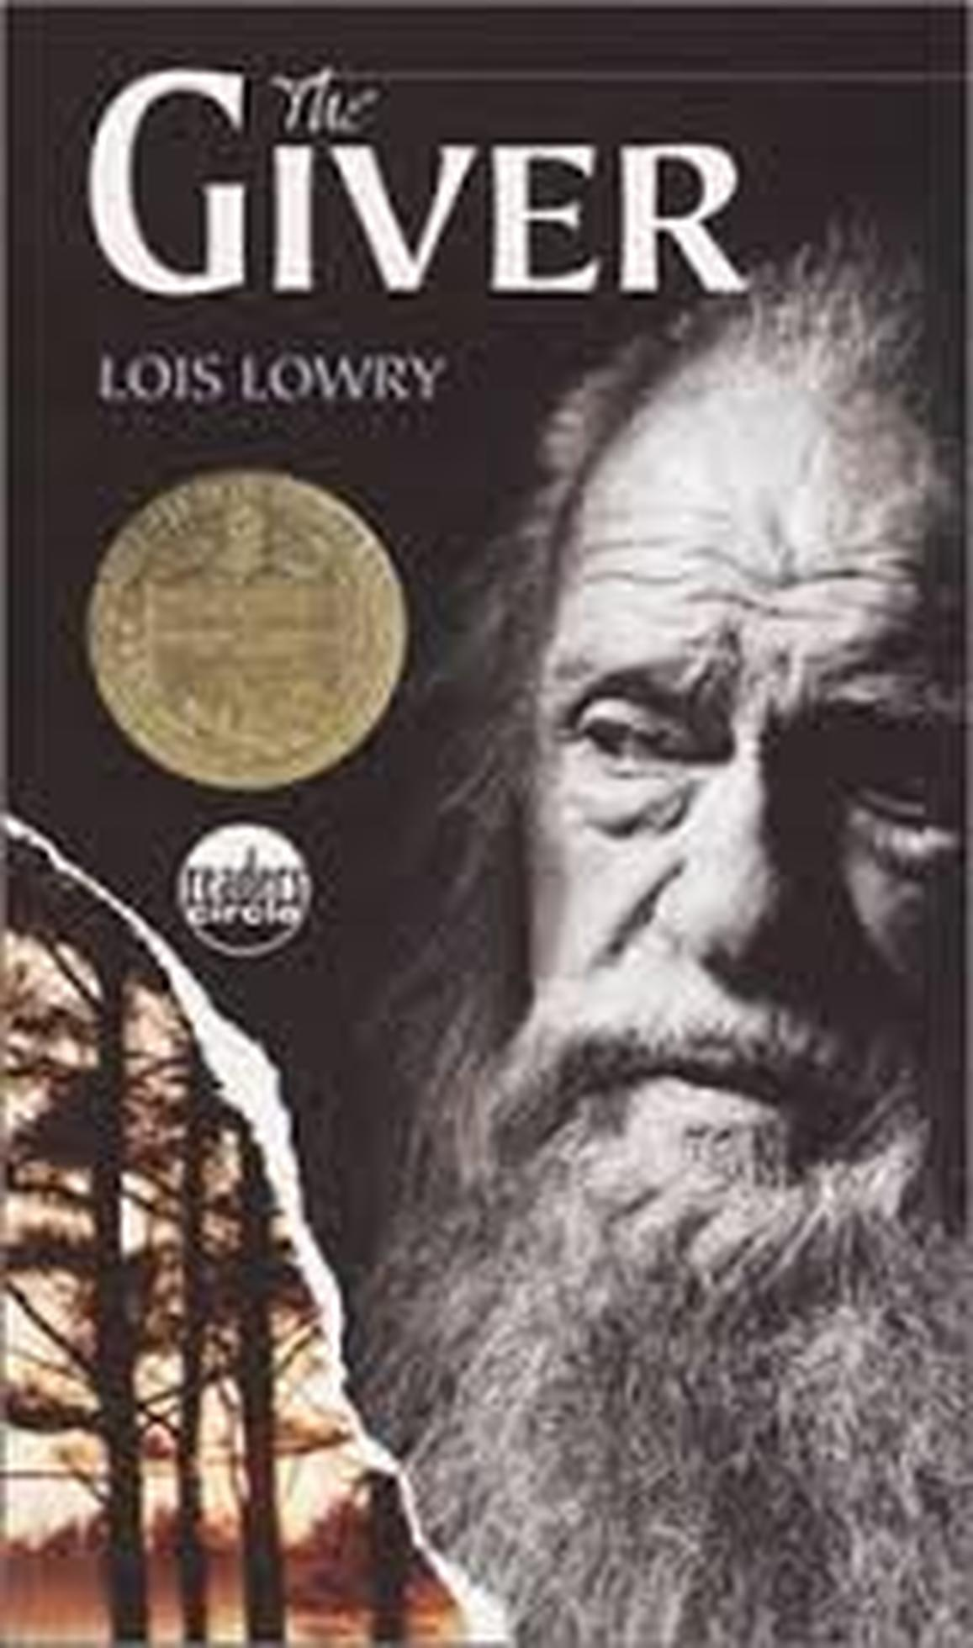
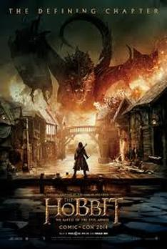
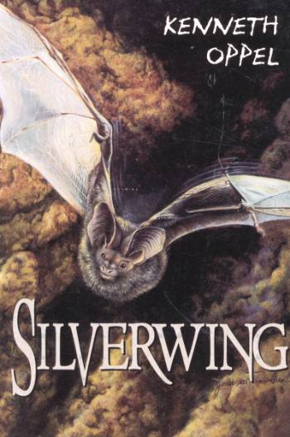
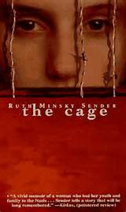
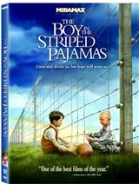
Grade 8 Novel Choices
Part of our Grade 8 ELA program involves
Two Novel Study Units – Term 2 and Term 4.
Student Choice Survey – Rank Top 4 Choices
Mixed Student Groups
Report to Homeroom for Daily AM Attendance.
Hallocaust Complete 1 of 3

Slide 3
The Giver by Lois lowry
The Giver – Lois Lowry
Identity and Freedom
Jonas's world is perfect. Everything is under control. There is no war or fear of pain. There are no choices. Every person is assigned a role in the community. When Jonas turns 12 he is singled out to receive special training from The Giver. The Giver alone holds the memories of the true pain and pleasure of life. Now, it is time for Jonas to receive the truth. There is no turning back.
Teacher: Mr. Evan Folden

Slide 4
Bifocal by Debrorah Ellis & Eric walters
Bifocal – Deborah Ellis and Eric Walters
Stereotypes, Identity, Choices
A quiet afternoon at a suburban high school is suddenly shattered by a lockdown: armed police fill the hallway, and a Muslim student suspected of terrorism is taken into custody. In Bifocal, award-winning YA authors Deborah Ellis and Eric Walters, using details that echo current news events, tell the story of two teens trying to remain faithful to the truth.
Although Jay is a new boy on the football team, he has already been anointed by the current captain, Kevin, so that gives him an edge in the weirdly stratified society that is high school. Haroon is a rising star, too, on the school’s team for the academic quiz show Reach for the Top. As the reasons for the lockdown are revealed and the investigation continues, it’s clear that Jay and Haroon are on a collision course.
Teacher: Ms. Roxanne Bitner

Slide 5
SILVERWING BY KENNETH OPPEL
There was a great war between the beasts of the land and the birds of the air. Both sides banished the Bats to the night since they did not take a side in the war. In the present day, a young undersized Silverwing bat named Shade dares to violate that law. As a result, the Owls demand he be surrendered to them for punishment. The Owls destroy the colony's home when the colony elder refuses to give up Shade. In the resulting premature migration Shade becomes separated on an island. Here he finds a new friend who is a Brightwing bat named Marina. Together, they set about to rejoin Shade's colony. Events are unfolding that threaten every bat colony, and perhaps the two young bats are the only hope to save them all.
Teachers: Ms. Kourtney Fesser/ Mr. Andrew Neufeldt

Slide 6
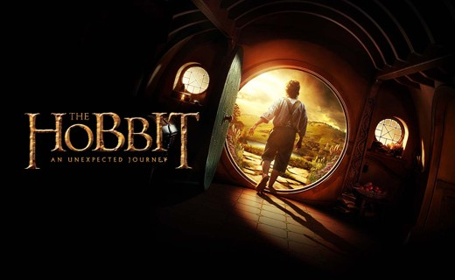
The hobbit by J.r.r. Tolkien
The Hobbit is a fantasy novel by English author J. R. R. Tolkien the prequel to his great trilogy – Lord of the Rings.
The Hobbit follows the quest of home-loving hobbit Bilbo Baggins to win a share of the treasure guarded by the dragon, Smaug.
Bilbo's journey takes him from light-hearted, rural surroundings into more sinister territory as Bilbo joins Thorin and Company on this great adventure.
Personal growth and forms of heroism are central themes of the story.
Teacher: Mr. Guy Farquharson

Slide 7
Tuck everlasting by Natalie Babbitt
Winnie Foster has everything a young woman could desire. She comes from a well-bred, wealthy, and respected family. She dresses in the finest clothes and is afforded every opportunity to refine herself. But Winnie finds that the heat of summer is not nearly as stifling as her gilded cage. She longs for freedom, for adventure. She escapes one morning to explore the woods surrounding her family's home, and encounters the Tucks, a close-knit family with a mysterious past that begs the question: If you could live forever, would you? And just when Winnie believes she has answered that question for herself, a mysterious man looking to profit from the source of the Tuck's immortality that will have her question her life, her desires, and what is the right thing to do. And in the end, learns, that death is not what is to be feared, but an unlived life.
Teacher: Ms. Angela Yedersberger

Slide 8
The Holocaust Novels
Teacher: Ms. Jillian Sawatzky
The focus of this group will explore the Holocaust experiences of several Jewish protagonists during WWII under Hitler’s Nazi conquering of Europe.
The Cage
The Boy in the Striped Pajamas
Daniel’s Story
You will need to choose 1 of the 3 Novels on this theme.

Slide 9
The holocaust novels
Teacher: Ms. Kirsten Taylor
The Cage
Daniel’s Story
The Boy in the
Striped Pajamas
Daniel's Story: A 14 year old boy looks through pictures as he rides a train bound for Auschwitz. He reflects on the events surrounding each of his photos. Part 2 of the book takes place in Auschwitz.
The Boy in the Striped Pajamas: 8 year old Bruno is the son of the newly appointed head of the SS at Auschwitz. Bruno is living in a house outside the compound and trying to understand what is going on around him. He befriends a young Jewish boy on the other side of the fence and together they try to understand the war and their place in it.
The Cage: Riva is a 15 year old girl living in the Warsaw ghetto. She must take care of her younger brothers after their mother dies. The book follows Riva from the Ghetto to a work camp.

Slide 10
Warman High School Grade 8 Novel Study Survey 2016
Student Name (First) __________________ (Last)_________________________
Circle Homeroom Form GF EF AN AY RB KT
Novel Teacher(s)
Silverwing Mr. Andrew Neufeldt
Ms. Kourtney Fesser ____________
The Giver Mr. Evan Folden ____________
Bifocal Ms. Roxanne Bitner ____________
The Hobbit Mr. Guy Farquharson ____________
Tuck Everlasting Ms. Angela Yedersberger ____________
The Holocaust Novels Ms. Jillian Sawatzky ____________
*If you choose this theme you will also need to choose from
One of The Cage Daniel’s Story The Boy in the Striped Pajamas
Instructions
You will be given a Grade 8 Novel Survey page that looks like this sample.
You need your first and last name with homeroom form .
Finally you will be asked to rank your choices from
First = 1 to Last = 4
*We will strive to get as many top two choices as possible.

