Slide 1
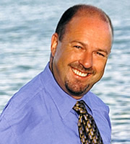
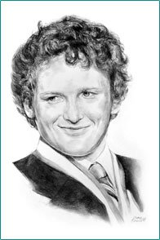
Body Image and self esteem
The Power of Positive self esteem and body image

Slide 2
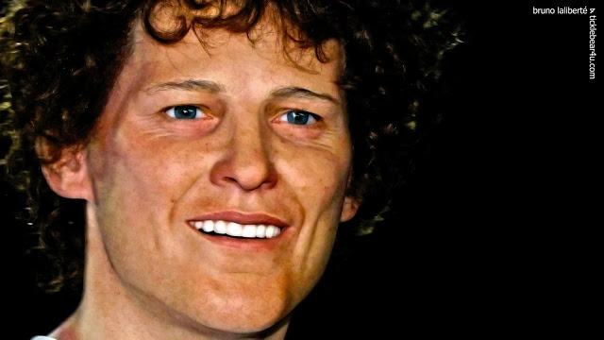
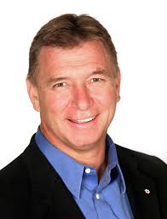
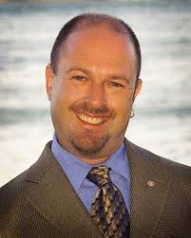
Can you recognize “positive Self esteem”?
What clues support your answer?
Do you recognize these famous Canadians?
Do you know their common story?

Slide 3
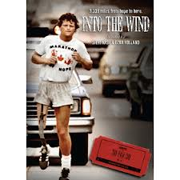
Terry Fox -
In 1977, 18-year-old Terry Fox, while a student at Simon Fraser University was diagnosed with bone cancer and lost his right leg to prevent the spread of the disease.
A True Canadian Hero
After 14 months of training, Terry convinced the Canadian Cancer Society to help sponsor his run across Canada to raise funds and awareness for cancer research.

Slide 4
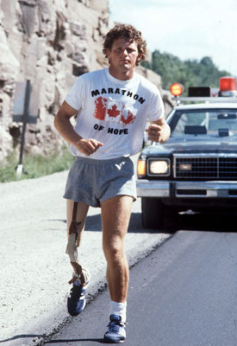
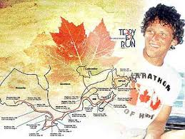
Terry fox
Averaging 26 miles per day, Terry continued the Run for 143 days as the country watched.
On September 1st 1980, Terry was just outside Thunder Bay ON when tragedy struck - he felt sharp pains in his chest. The cancer he he thought he had conquered had spread to his lungs.
A Canadian Legend
On April 12th 1980, Terry dipped his artificial leg into the Atlantic Ocean and began his Marathon of Hope across Canada.
He returned to Vancouver for more treatments but lost his battle with cancer on June 28th 1981, exactly one month shy of his 23rd birthday.

Slide 5
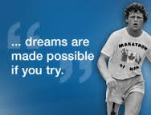
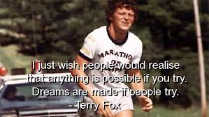
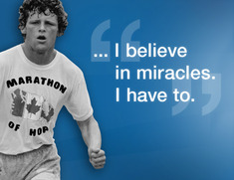
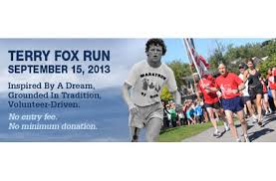
Terry Fox – Marathon of hope
Although Terry did not complete his Marathon, his Run had raised $24.2 million for the cause of cancer research and he became an inspiration to millions of people worldwide.
The Terry Fox Run continues to this day – as Canadians and others world wide continue Terry’s Marathon of Hope – contiuning to raise funds for Cancer Research every September!

Slide 6
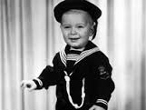
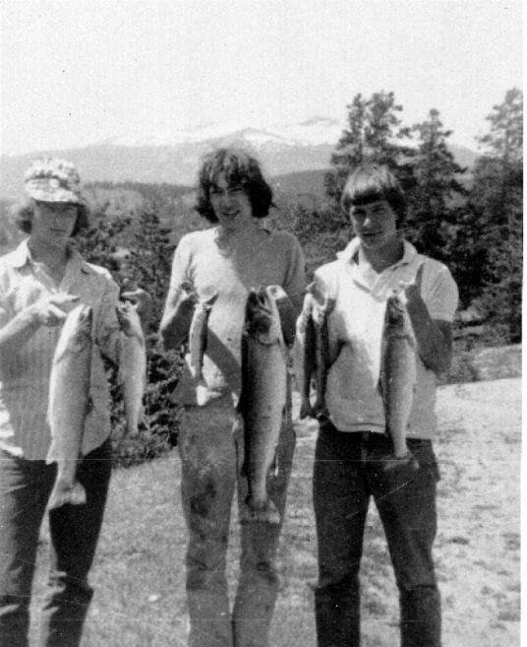
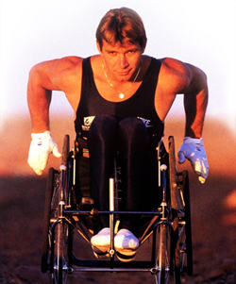
Rick Hansen grew up in Williams Lake, British Columbia. As a young athlete, he had won all-star awards in five sports.
He was paralyzed at the age of 15 from being in the back of a truck with his friend, when suddenly the pick up truck swerved and hit a tree. He left the bed of the truck from the impact and received a spinal cord injury.
Hansen won national championships on wheelchair volleyball and wheelchair basketball teams. He went on to become a world class champion wheelchair marathoner and Paralympic athlete. He competed in wheelchair racing at both the 1980 and 1984 Summer Paralympics, winning a total of three gold, two silver, and one bronze medal.[

Slide 7
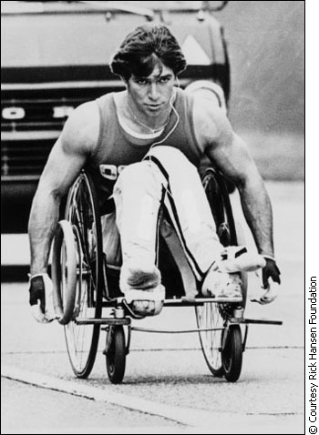
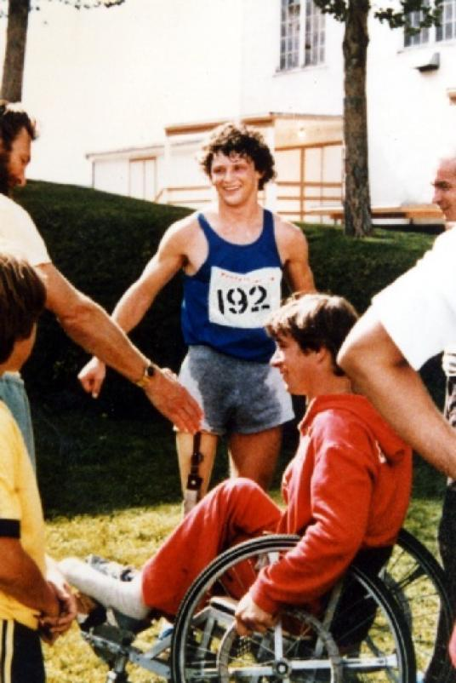
The Power of influence
Rick met Terry Fox and the two became great friends.
Terry Fox’s Marathon of Hope inspired Rick to take on his own “Man in Motion Tour”

Slide 8
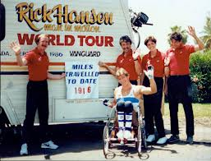
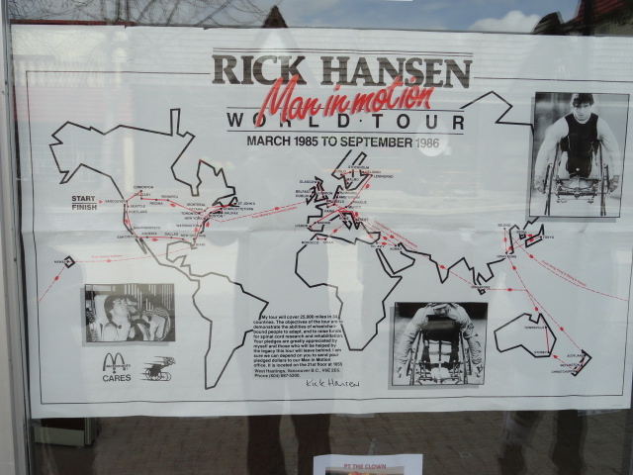
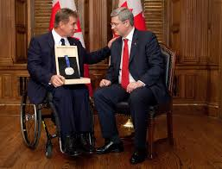
In March 1985, Rick began his trek around the world – in his wheel chair!
This successful effort established the Rick Hansen Foundation which dedicates funds towards spinal injuries.
Man in Motion - World Tour
The Rick Hansen Foundation continues today!

Slide 9
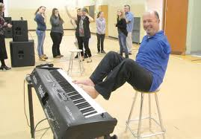
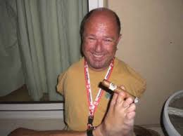
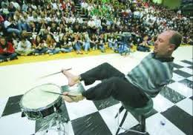
ALVin Law
Alvin Law is a motivational speaker and former radio broadcaster.^{[1]}
Alvin Law was born in Yorkton, Saskatchewan -without arms as a consequence of his mother's use of thalidomide while pregnant.
Law learned to perform routine activities using his feet alone, including eating, dressing and grooming himself, driving, sewing, playing sports, and playing drums, piano, and trombone.
Born to inspire others!

Slide 10
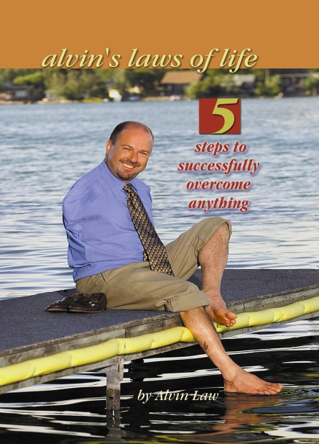
After graduating from college, Law embarked on a successful career in radio broadcasting. He expressed an interest in moving to television, but network executives were unsure of how the public would react to an armless news anchor
Law began dabbling in motivational speaking in 1981. In 1988 he made this his full-time occupation with the founding of AJL Communications Ltd.
He is the subject of two award-winning documentaries, and is the author of a book, Alvin's Laws of Life: 5 Steps To Successfully Overcome Anything. He has also dabbled in acting, his most notable role to date being a preacher in an X-Files episode.
.
In 1986, Law ran as a Saskatchewan Progressive Conservative Party candidate in the 1986 provincial election, losing in a Regina constituency.
Click Here

Slide 11
The Power of positive self ESTEEm
Terry Fox
On a new page complete each of the following to submit at the end of this class. Be sure to include the above title and your name.
1. Write a short 3 paragraphs introducing each of these Canadians .
2. Make a list of the 3-5 similarities these men share.
3. What is the common theme to that all three men are communicating?
4. How have each of these men influenced others with their message?
5. Each of these men demonstrate high self esteem – explain how each man’s life would have been different with low self-esteem.
Rick Hansen
Alvin Law

